Slide 1
Netflix Movie and TV Show Trend
Rolly Costillas, Derek Mast,
Matthew Hill, Chang Woon Jang

Slide 2
Introduction
Background and Datasets
Question: How does Netflix keep its user base interested and continue to do so?
1) Movies or TV shows in the past?
2) Specific genres of movies and TV shows based on past trends?
3) Relationship between a country and the number of movies and TV shows?
4) Does is this trend consistent each country?
5) Is it reflection of what Netflix wants to focus on?
Kaggle Datasets and OMDBapi
Pandas/Matplotlib/Numpy/Scipy/Python API

Slide 3
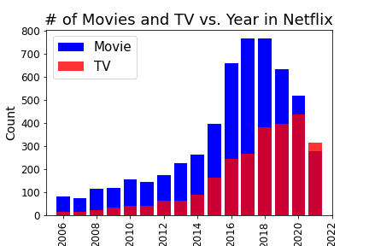
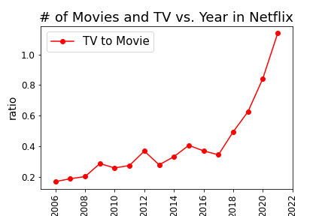

Movie and TV Productions from 2006 to 2021
Movies or TV shows Trends in the past?
Overall, movies has been more produced than TV shows
The ratio of TV to Movie recently increases
Trend might shift to TV shows in the future
https://www.kaggle.com/datasets/shivamb/netflix-shows

Slide 4
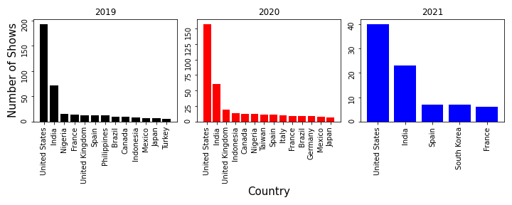
Production by Country from 2019 to 2021
Movies or TV shows in the past?
United States overwhelms other countries in Netflix production
Number of productions decrease from 2019 to 2021
https://www.kaggle.com/datasets/shivamb/netflix-shows

Slide 5
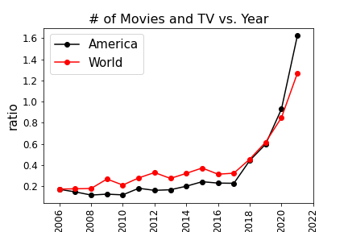
Movie and TV Productions from 2006 to 2021

Slide 6
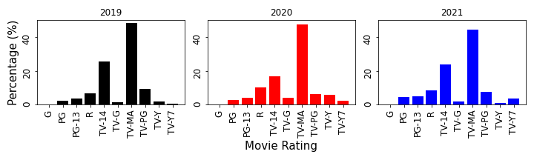
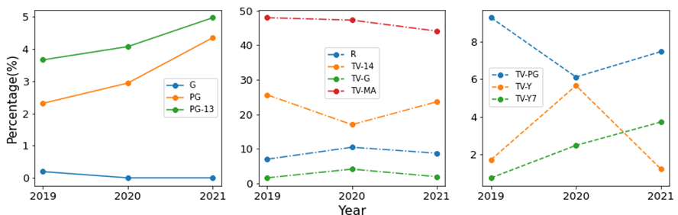
Popularity by Rating from 2019 to 2021
Movies or TV shows in the past?
TV-MA rating always high but
decreasing
PG, PG-13, TV-Y7 is increasing

Slide 7
Discussion and Conclusion
TV Shows are often cheaper to make and is usually 2-10 times faster than Movies in production.
Dataset might demonstrate that Netflix is leaning towards TV shows in the future because it has a higher profit margin, or it is cheaper to stream on their services.

Slide 8
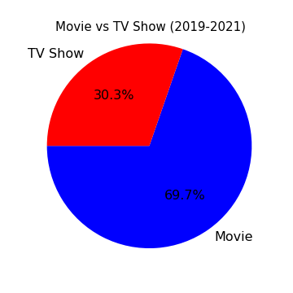
Does Netflix prefer movies or tv shows?
This visualization shows genres of both tv shows and movies.
It is known that movies are far high compared to tv shows in the last three years.

Slide 9
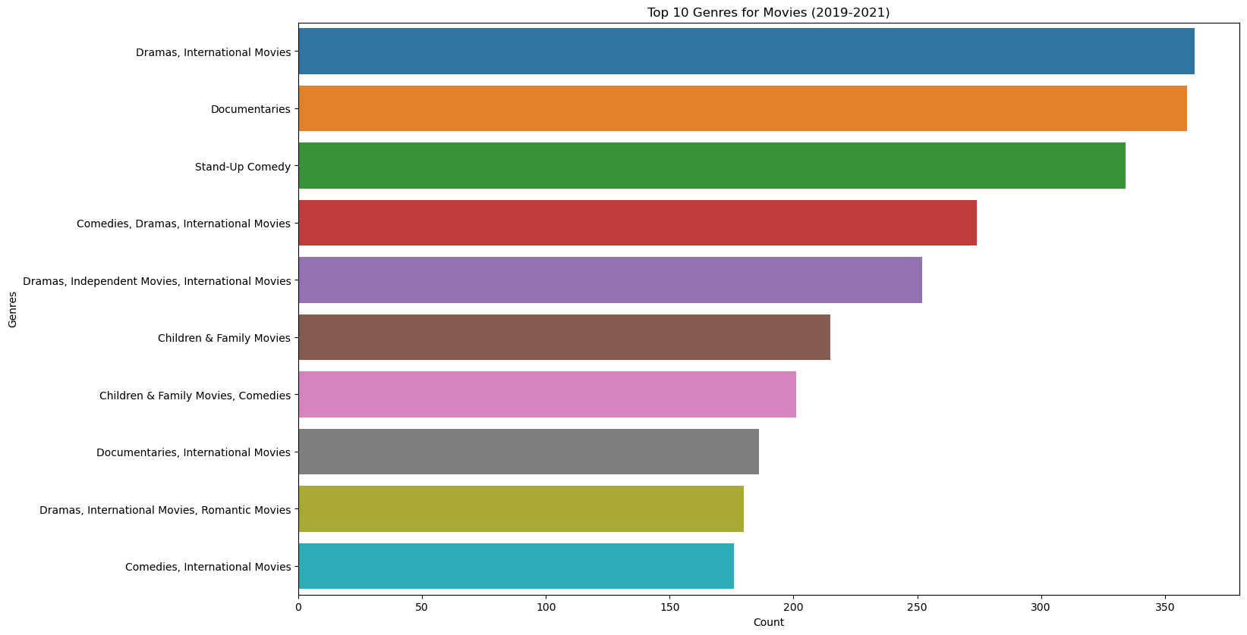
What are the top genres distributed by Netflix for movies in the last three years (2019, 2020, 2021)?
Netflix offers range of movie genres and most of the content have multiple genres.
In the last there years, movie contents is dominated by international genre due to Netflix international presence, which is tied with drama.

Slide 10
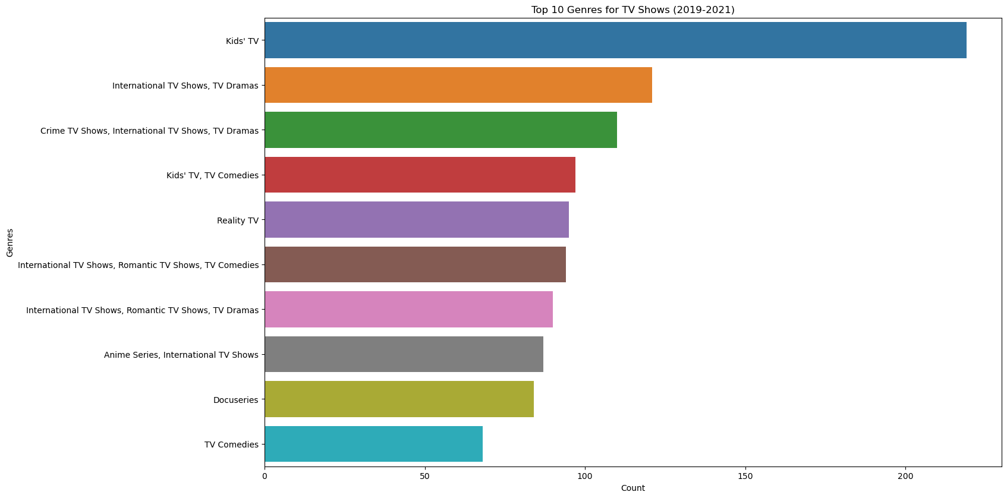
What are the top genres distributed by Netflix for tv shows in the last three years (2019, 2020, 2021)?
Netflix offers range of tv show genres and most of the content have multiple genres.
It is clear that tv show contents is dominated by kids’ tv genre followed by international tv shows which is tied with tv dramas.

Slide 11
Discussion and Conclusion
Incorporate and discuss the effect of Covid during the height of the pandemic in producing contents (movies or tv shows) during those years 2019, 2020 & 2021. A movie is short as compared to a tv show. A tv show is a series movie. This is the time when people chose to quarantine. Every country/region likes to produce content based off of their preferential choices. Duration is another interesting feature to analyze, because most of the tv content is follow season representation, were as movies follow time in minutes. This could help us understand user preference of content, whether user like binge watching or short time user.
Netflix offer range of genre to subsribers, for comdeies to tragedy , documnetaries to talk shows, It would be fun to analyze this feature. One interesting thing to notice is that most of the content fells into to multiple genre so, we can visulaize single genre contet and multiple genre content as well. It is known that movies are far high compared to tv shows. This visualization shows genres of both tv shows and movies.
from above visulaization it is clear most of the content on platform is comidies and intenational films. Due to international presence of the Netflix, mostly content is international contents, followed by dramas and comedies. Also, seems like most of the Netflix content is multi-genre, and mostly movies have range of genres.

Slide 12
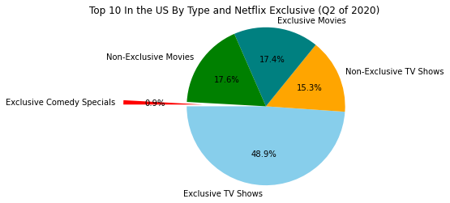
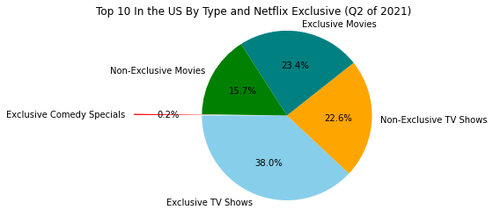
What was the popular type of entertainment on Netflix during the pandemic?
Popularity by Type During the Pandemic-Q2/2020 vs. Q2/2021
Compared the results between the two quarters
Netflix Exclusive TV shows and Non-Exclusive Movies-both dropped in popularity.
We could see that Netflix Exclusive movies increased over the same time period along with Non-Exclusive TV shows.
https://www.kaggle.com/datasets/prasertk/netflix-daily-top-10-in-us

Slide 13
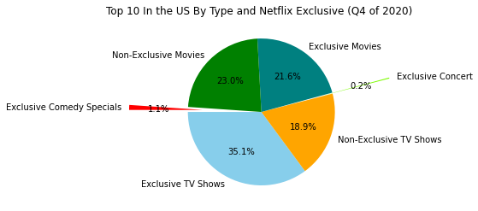
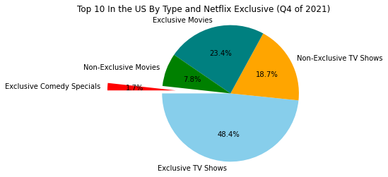
What was the popular type of entertainment on Netflix during the pandemic?
Popularity by Type During the Pandemic-Q4/2020 vs. Q4/2021
Compared the results between the two quarters.
Netflix Exclusive TV shows increased a lot bringing it back to the around the same level as the 2nd quarter of 2020.
We could see that Netflix Exclusive movies increased slightly over the same time period but the non-exclusive movies and TV shows remained around the same or decreased.
Throughout the data, we could see a small number of comedy specials in the daily Top 10 that resulted no more than 1-2% per quarter.
https://www.kaggle.com/datasets/prasertk/netflix-daily-top-10-in-us

Slide 14
Discussion and Conclusion
Based on the results from the pandemic, we can see that most people preferred to watch TV shows within the United States. This is likely to have been a result of the lockdowns and people had more time to watch TV shows.
The popularity of certain TV shows (example-Tiger King) resulted in more people watching specifically Netflix exclusive TV shows.
Netflix is likely capable of being able to produce TV shows at a faster rate than movies. This is likely why they are more popular as there are more options for users.
https://www.kaggle.com/datasets/prasertk/netflix-daily-top-10-in-us

Slide 15
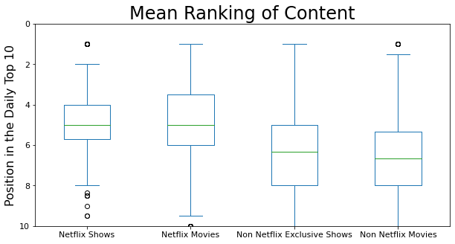
What Kind of Content Appeared in the Daily Top 10?
Using the ranking in the Daily Top 10 as a metric for popularity:
It appears that Netflix produced content ranked higher on average
Shows tended to do slightly better than movies
https://www.kaggle.com/datasets/prasertk/netflix-daily-top-10-in-us

Slide 16
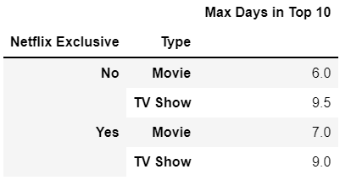
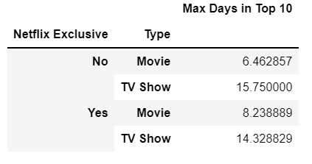
What Kind of Content Appeared in the Daily Top 10?
Median
Now let’s look at how many days something spent in the top 10
Shows spent more time in the Top 10 than movies
Little difference between Netflix and non-Netflix content
Mean
Mean time in the Top 10 shows a much stronger lean towards shows, indicating the presence of outliers
https://www.kaggle.com/datasets/prasertk/netflix-daily-top-10-in-us

Slide 17
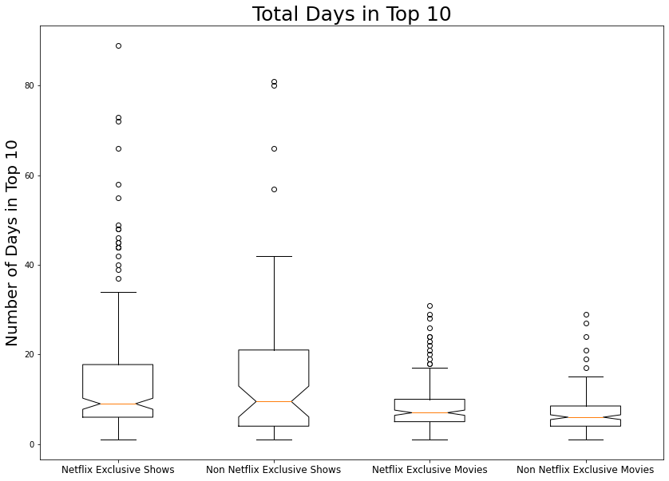
What Kind of Content Appeared in the Daily Top 10?
The bulk of shows were on the Top 10 list for 5 to 20 days, with frequent outliers staying much longer
Movies stayed on the Top 10 mostly for less than 10 days, and never more than 40
Important to note that “Cocomelon” was removed from the data for this graph, it appeared a total of 428 days out of 710. Making the Top 10 list 60% of the time
https://www.kaggle.com/datasets/prasertk/netflix-daily-top-10-in-us

Slide 18
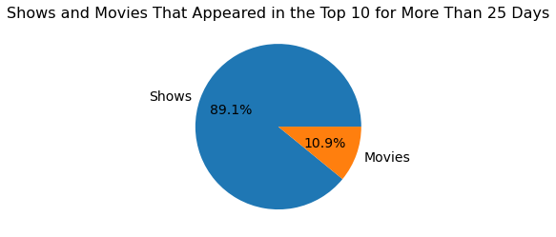
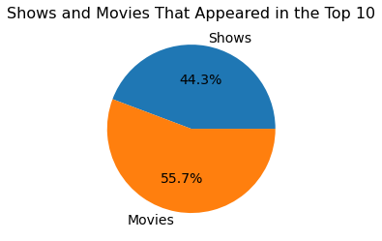
What Kind of Content Appeared in the Daily Top 10?
Limiting our view to only those shows and movies that were in the Top 10 for 25 days or more, we see that it is mostly shows.
Even though movies appeared more often in the Top 10, shows spent far more time there
https://www.kaggle.com/datasets/prasertk/netflix-daily-top-10-in-us

Slide 19
What Kind of Content Appeared in the Daily Top 10?
Shows appeared in the Daily Top 10 more often and stayed for much longer than movies
While shows tended to do somewhat better than movies on average, the top performing slots were overwhelmingly slanted towards shows.

